Slide 1

Submitted by :

Slide 2

Project Overview
This project focuses on analysing customer data to understand patterns, behaviours, and key factors influencing customer churn. Using Exploratory Data Analysis (EDA), we examine relationships between variables such as demographics, services, and payment methods to uncover actionable insights.
The goal is to transform raw data into meaningful information that supports business decision-making and improves customer retention strategies.

Slide 3

Project Objectives
Identify key factors contributing to customer churn
Analyse customer demographics and service usage patterns
Detect trends and correlations between variables
Segment customers based on behaviours
Provide data-driven recommendations to reduce churn

Slide 4
Business Problem Statement
Customer churn is a major challenge for businesses, as losing customers directly impacts revenue and growth.
The company is experiencing a high churn rate and lacks clarity on:
Why customers are leaving
Which customer segments are most at risk
What services or features influence churn
The objective is to analyse customer data and uncover insights that help reduce churn and improve retention.

Slide 5
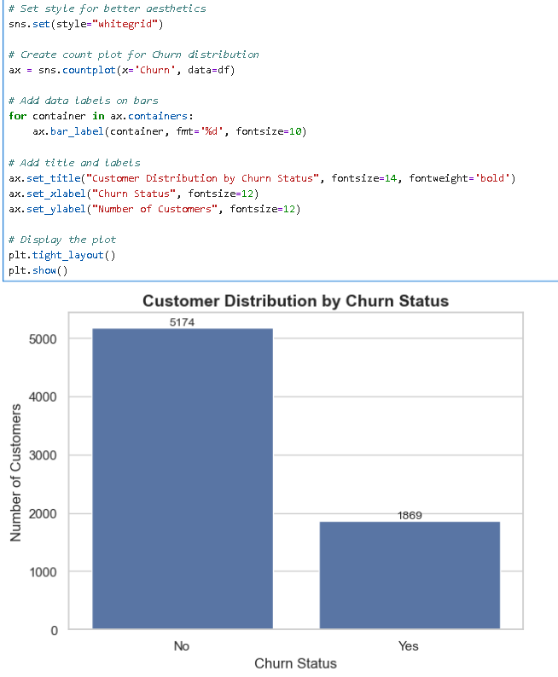
Customer Distribution by Churn Status
The above chart shows the distribution of customers based on their churn status.
A significantly larger number of customers (5174) have not churned, indicating that they continue to use the company’s services.
In contrast, a smaller portion (1869) of customers have churned, meaning they have discontinued the service.
👉 This indicates that while the majority of customers are retained, there is still a considerable number of customers leaving the company.

Slide 6
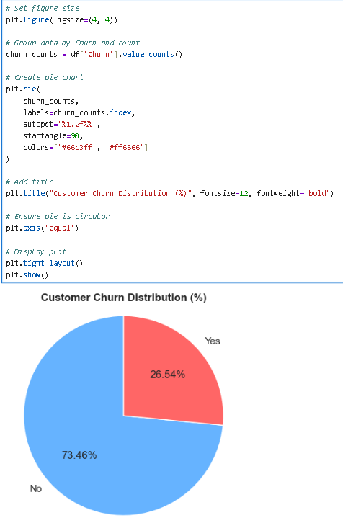
Customer Churn Distribution (%)
The pie chart represents the percentage distribution of customers based on their churn status.
Approximately 73.46% of customers have not churned, indicating strong customer retention.
Around 26.54% of customers have churned, showing a significant portion of customers leaving the service.
Key Insight
The majority of customers are retained, which is a positive sign for the business.
However, more than one-fourth of customers churning is a concern and requires attention.

Slide 7
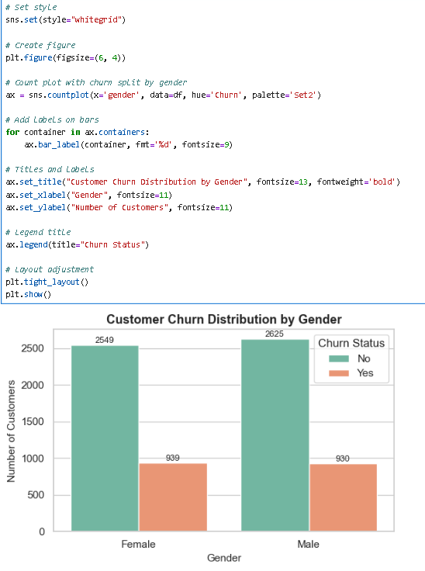
Customer Churn Distribution by Gender
The chart compares customer churn behavior across gender categories.
Among female customers, 2549 have not churned while 939 have churned.
Among male customers, 2625 have not churned while 930 have churned.
👉 The number of retained customers is significantly higher than churned customers for both genders.
🎯 Key Insight
Churn levels are almost similar for both male and female customers
Gender does not appear to be a major factor influencing churn

Slide 8
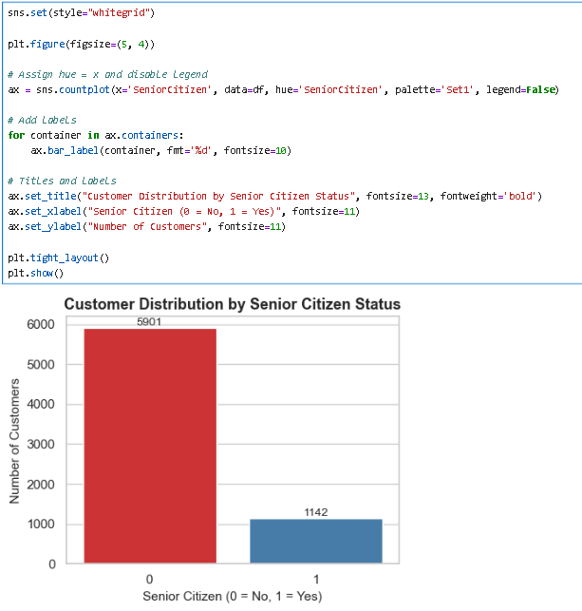
Customer Distribution by Senior Citizen Status
The chart shows the distribution of customers based on Senior Citizen status. Out of the total customers, 5901 are non-senior citizens (0), while only 1142 are senior citizens (1).
👉 The majority of customers belong to the non-senior category. 👉 Senior citizens make up a much smaller portion of the customer base.
Key Insight The dataset is heavily skewed towards non-senior customers, indicating that most customers are younger individuals, with senior citizens representing a relatively small segment.

Slide 9
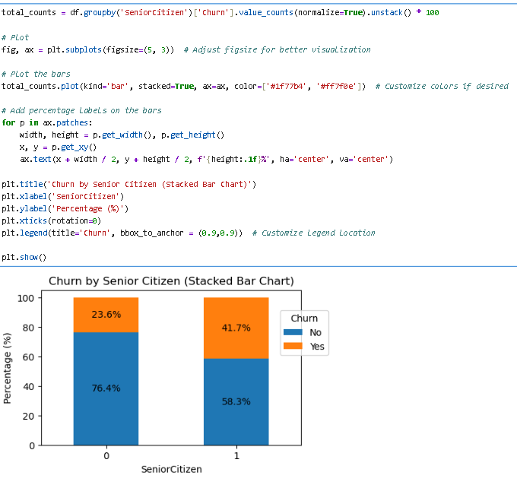
Churn by Senior Citizen
The chart compares customer churn behavior across Senior Citizen categories. Among non-senior customers, 76.4% have not churned while 23.6% have churned. Among senior citizens, 58.3% have not churned while 41.7% have churned.
👉 Non-senior customers show higher retention compared to senior citizens. 👉 Senior citizens have a noticeably higher churn percentage.
Key Insight Senior citizens are more likely to churn compared to non-senior customers, indicating that age group plays a significant role in customer retention.

Slide 10
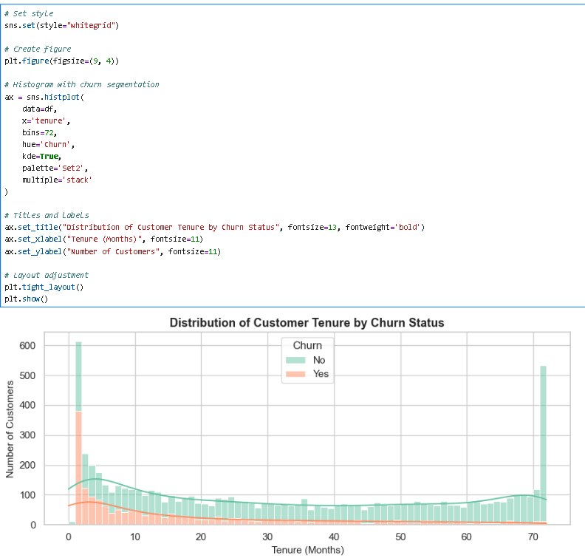
Distribution of Customer Tenure by Churn Status
The chart compares customer churn behavior across different tenure (in months).
Customers with very low tenure (0–10 months) show a high concentration of churn, with a significant portion leaving early. As tenure increases, the number of churned customers gradually declines, while non-churned customers become more dominant.
👉 Early-stage customers (especially within the first year) are more likely to churn. 👉 Customers with higher tenure (above ~40–50 months) exhibit strong retention and minimal churn.
Key Insight Customer churn is highest during the initial months of service, highlighting the importance of improving early customer experience and engagement to boost long-term retention.

Slide 11
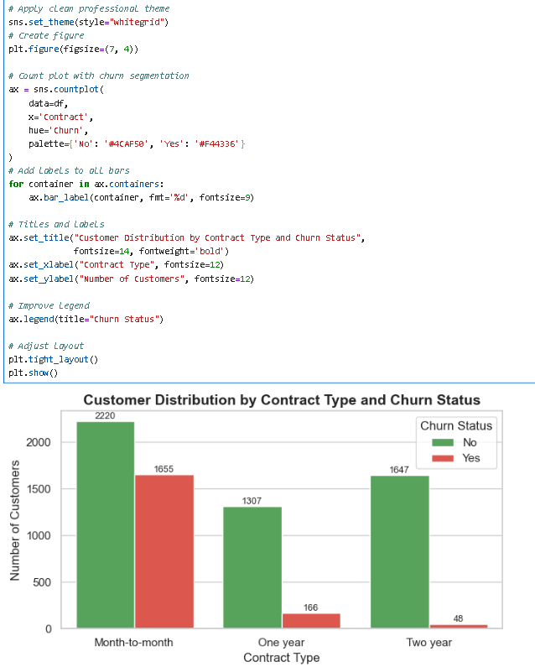
Customer Distribution by Contract Type and Churn Status
The chart compares customer churn behavior across different contract types.
Among month-to-month customers, a large number have churned (1655) compared to those retained (2220), indicating relatively high churn. In contrast, one-year contracts show significantly lower churn (166 vs 1307 retained), and two-year contracts have the lowest churn (only 48 vs 1647 retained).
👉 Month-to-month contracts have the highest churn rate, showing customers are more likely to leave without long-term commitment. 👉 Long-term contracts (one-year and especially two-year) have much stronger retention and minimal churn.
Key Insight Contract type strongly influences churn—customers on longer-term contracts are far more likely to stay, while month-to-month customers are at the highest risk of churning.

Slide 12
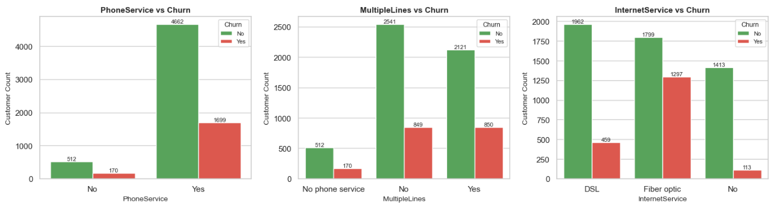
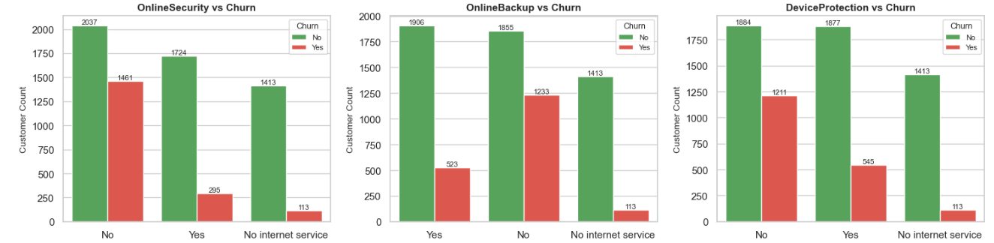

Slide 13
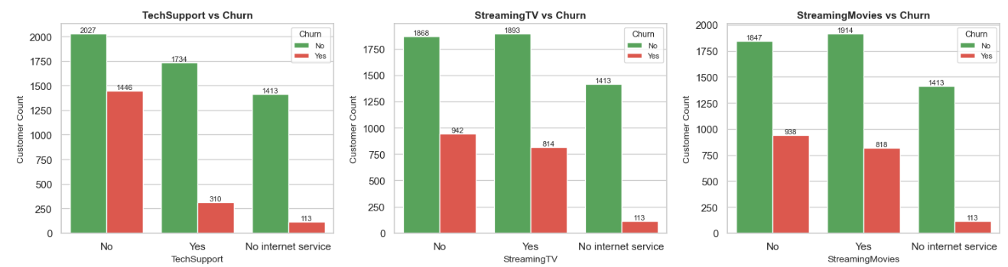

Slide 14
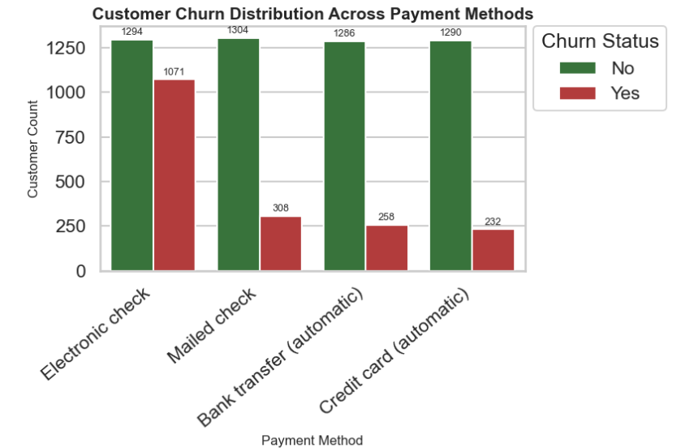
Customer Churn Distribution Across Payment Methods
The chart compares customer churn behavior across different payment methods.
Among customers using electronic check, a high number have churned (1071) compared to those retained (1294), indicating the highest churn among all payment methods. In contrast, customers using mailed check show lower churn (308 vs 1304 retained), while bank transfer (automatic) and credit card (automatic) have the lowest churn levels (258 and 232 respectively, with strong retention in both cases).
👉 Electronic check users show the highest churn, suggesting less stable or less satisfied customers. 👉 Automatic payment methods (bank transfer and credit card) demonstrate significantly better retention and lower churn.
Key Insight Payment method plays an important role in churn—customers using automatic payment options are more likely to stay, while those using electronic checks are at a higher risk of churning.

Slide 15
Recommendations
🎯 Encourage long-term contracts through discounts or benefits
🔒 Bundle services like online security & tech support
💳 Promote stable payment methods (auto-pay, credit cards)
📞 Improve onboarding experience for new customers
💰 Offer loyalty rewards for long-tenure customers
⚡ Review pricing strategy for high-cost plans

Slide 16
Conclusion
The EDA reveals clear patterns behind customer churn, highlighting the importance of contract type, service usage, and payment behaviour.
By implementing targeted strategies such as improving service bundles, optimizing pricing, and enhancing customer experience, the company can significantly reduce churn and improve customer retention.

